Slide 1

Pizza Sales Analysis
Insights from Order Data using SQL
Presented By: Amil Dev S

Slide 2
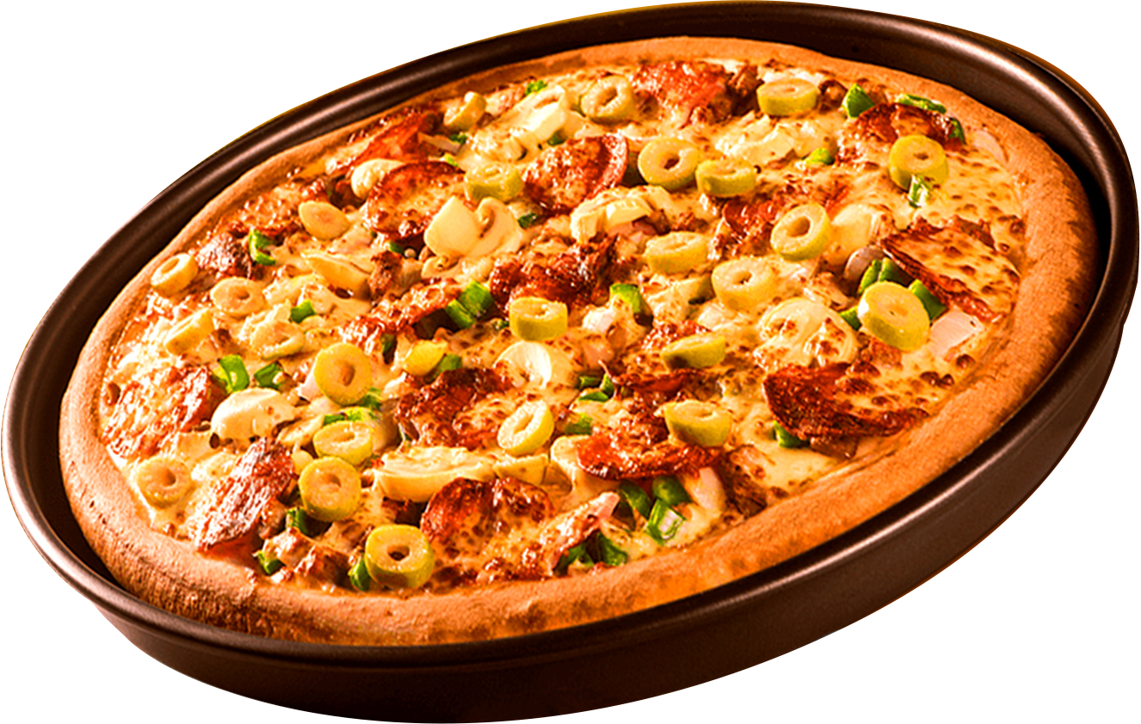

Welcome to the Pizza Sales Analysis presentation, where we delve into valuable insights derived from our order data.

Slide 3
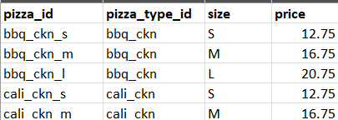
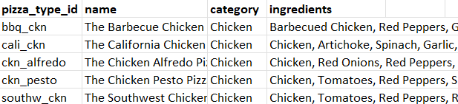
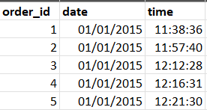
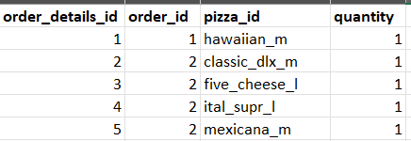
DATASET
Pizzas Table
Pizza Type Table
Orders Table
Order Details Table
Dataset: : https://github.com/Ayushi0214/pizza-sales---SQL

Slide 4
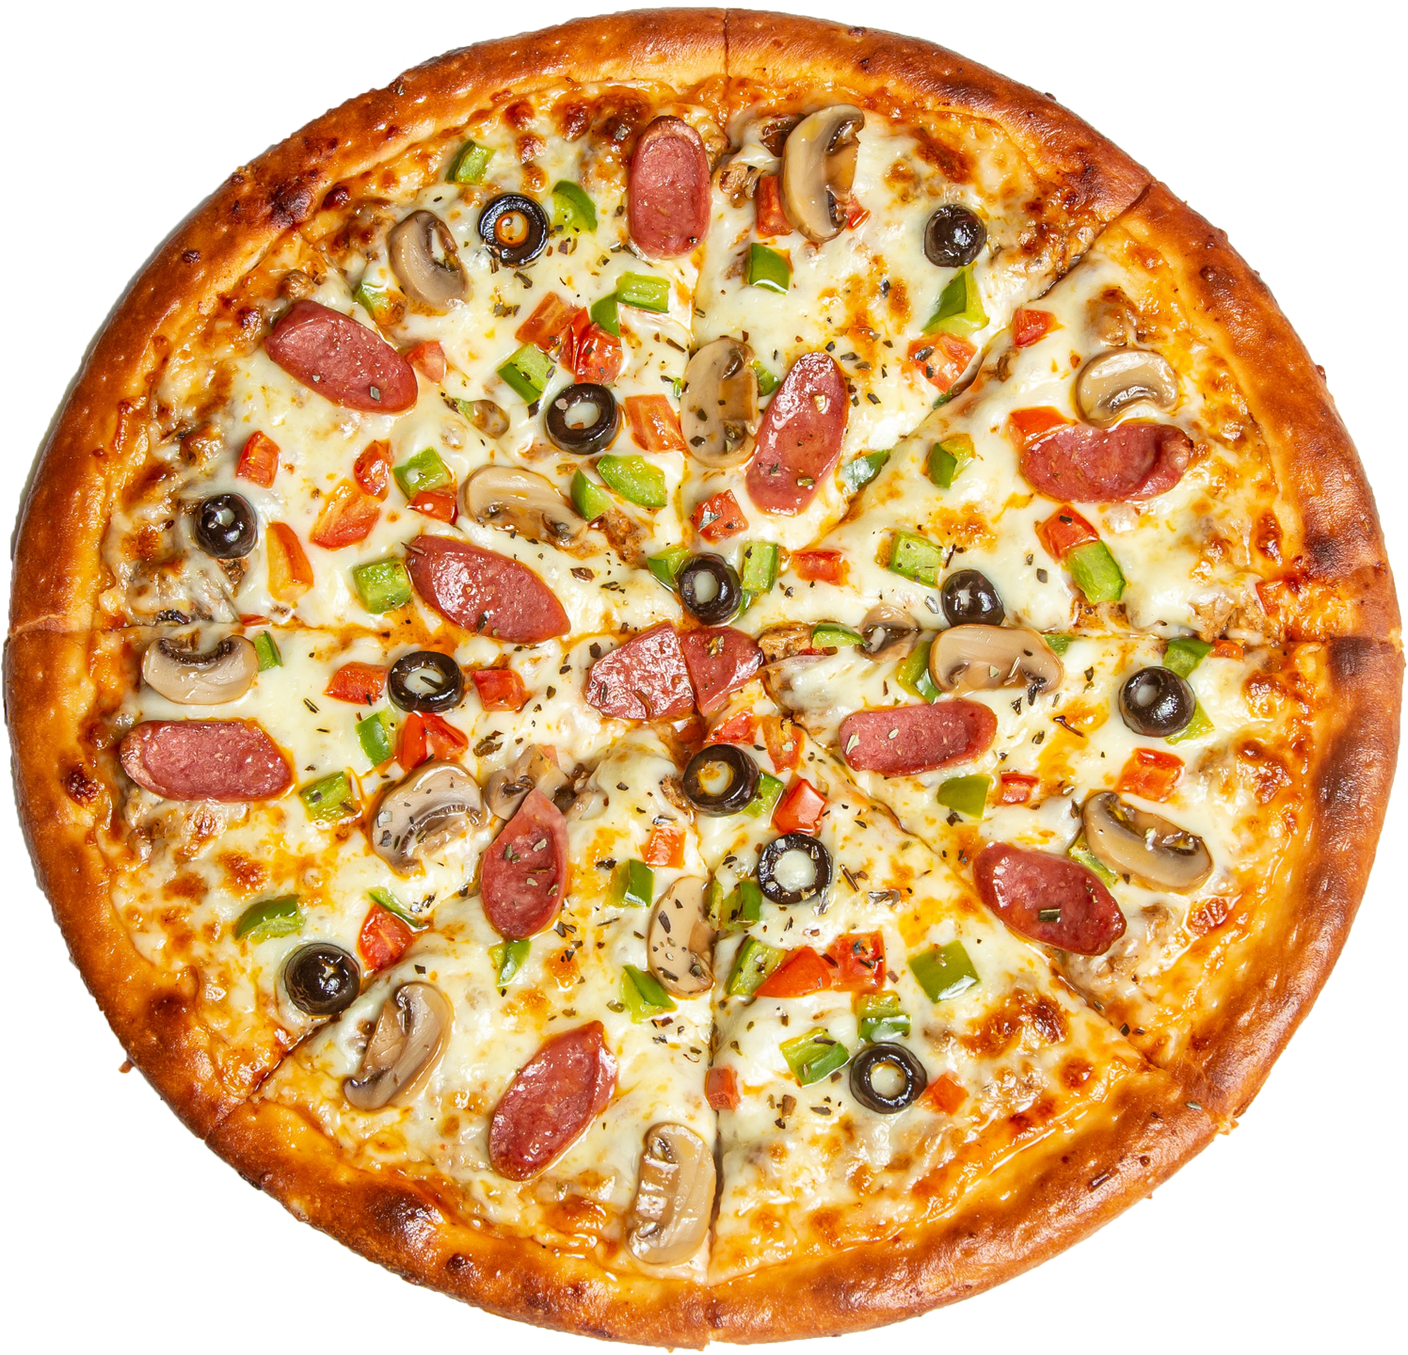
In this analysis, we aim to uncover trends, patterns, and key metrics to optimize our pizza sales strategy.
Questions:
Retrieve the total number of orders placed:
Calculate the total revenue generated from pizza sales:
Identify the highest-priced pizza:
Identify the most common pizza size ordered:
What is the total revenue generated from each pizza category?
What is the average price of pizzas ordered?
List the dates with the highest number of orders.
List the dates with the lowest number of orders.

Slide 5
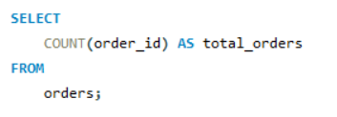
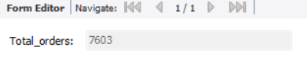
Retrieve the total number of orders placed:

Slide 6
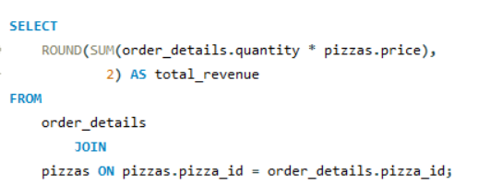
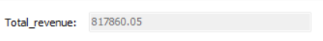
Calculate the total revenue generated from pizza sales:

Slide 7
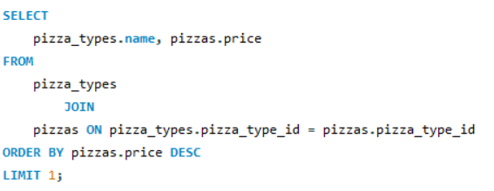
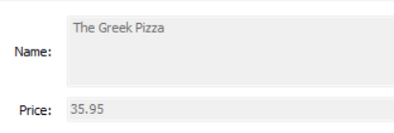
Identify the highest-priced pizza.

Slide 8
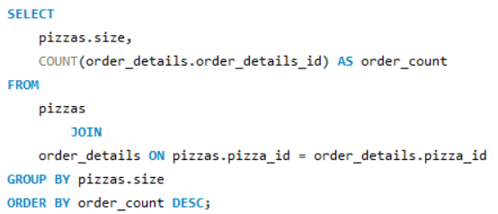
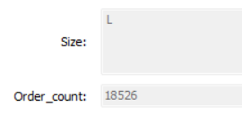
Identify the most common pizza size ordered.

Slide 9
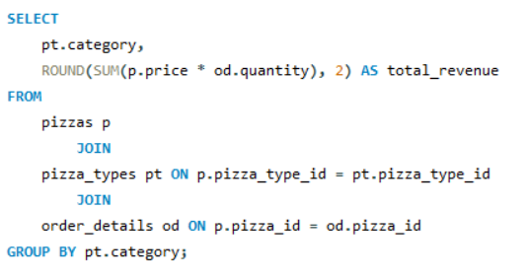
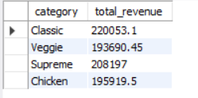
What is the total revenue generated from each pizza category?

Slide 10
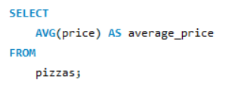
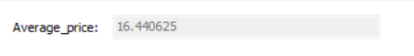
What is the average price of pizzas ordered?

Slide 11
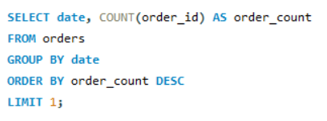
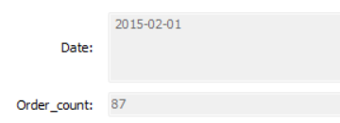
List the dates with the highest number of orders.

Slide 12
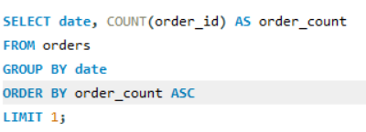
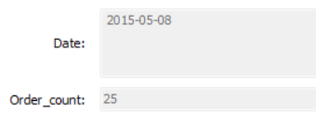
List the dates with the lowest number of orders.

Slide 13
In conclusion, our analysis reveals valuable insights into our pizza sales performance.
CONCLUSION
By leveraging these insights, we can refine our strategies to enhance customer satisfaction and drive revenue growth.

Slide 14



THANK YOU
Thank you for your attention and engagement during this presentation.
linkedin.com/in/amildevs/
amildev8547@gmail.com
+91-7306825950

